Slide 1
Fairness-aware Classifier with Prejudice Remover Regularizer
Toshihiro Kamishima*, Shotaro Akaho*, Hideki Asoh*, and Jun Sakuma†
*National Institute of Advanced Industrial Science and Technology (AIST), Japan
†University of Tsukuba, Japan; and Japan Science and Technology Agency
ECMLPKDD 2012 (22nd ECML and 15th PKDD Conference)
@ Bristol, United Kingdom, Sep. 24-28, 2012
Present by: Xuehan Chen
Date: 03/07/2021
Notes:
With the spread of data mining technologies and the accumulation
of social data, such technologies and data are being used for
determinations that seriously aect individuals' lives. For example, credit
scoring is frequently determined based on the records of past credit data
together with statistical prediction techniques. Needless to say, such determinations
must be nondiscriminatory and fair in sensitive features,
such as race, gender, religion, and so on.

Slide 2
Outline
Applications
fairness-aware data mining applications
Difficulty in Fairness-aware Data Mining
Calders-Verwer’s discrimination score, red-lining effect
Fairness-aware Classification
fairness-aware classification, three types of prejudices
Methods
prejudice remover regularizer, Calders-Verwer’s 2-naïve-Bayes
Experiments
experimental results on Calders&Verwer’s data and synthetic data
Related Work
privacy-preserving data mining, detection of unfair decisions,
explainability, fairness-aware data publication
My opinion

Slide 3
Overview
Fairness-aware Data Mining
fairness, discrimination, neutrality, or independence
fairness-aware classification, regression, or clustering
detection of unfair events from databases
fairness-aware data publication
Notes:
The use of data mining technologies in our society will only become greater
and greater. Unfortunately, their results can occasionally damage people's lives
[2]. On the other hand, data analysis is crucial for enhancing public welfare. For
example, exploiting personal information has proved to be eective for reducing
energy consumption, improving the eciency of trac control, preventing infectious
diseases, and so on. Consequently, methods of data exploitation that do not
damage people's lives, such as fairness/discrimination-aware learning, privacypreserving
data mining, or adversarial learning, together comprise the notion of
socially responsible mining, which it should become an important concept in the
near future.

Slide 4
Examples of Fairness-aware Data Mining Applications
Elimination of Discrimination
Information Neutral Recommender System
ex. credit scoring, insurance rating, employment application
socially sensitive information: gender, religion, race
Social media make biased recommendations ex. conservative or progressive people
Notes:
serious decisions. exclude the influ of socially sensitive information: gender, religion, race,…

Slide 5
Outline
Applications
fairness-aware data mining applications
Difficulty in Fairness-aware Data Mining
Calders-Verwer’s discrimination score, red-lining effect
Fairness-aware Classification
fairness-aware classification, three types of prejudices
Methods
prejudice remover regularizer, Calders-Verwer’s 2-naïve-Bayes
Experiments
experimental results on Calders&Verwer’s data and synthetic data
Related Work
privacy-preserving data mining, detection of unfair decisions,
explainability, fairness-aware data publication
Conclusion

Slide 6
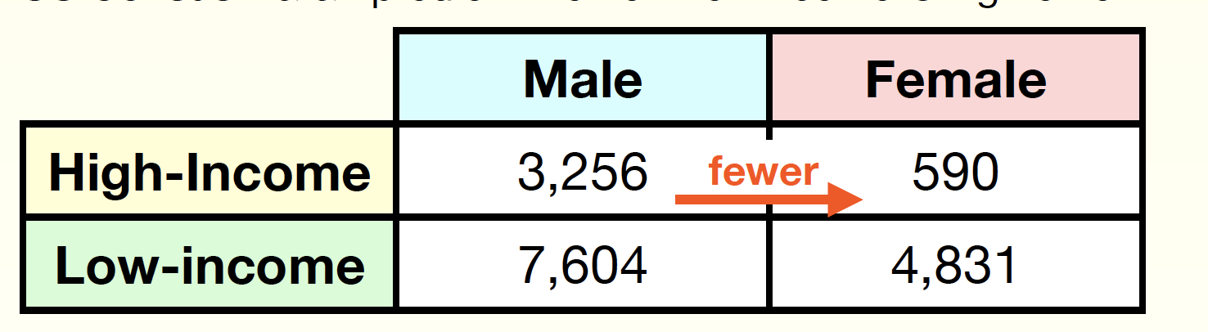
Difficulty in Fairness-aware Data Mining
US Census Data : predict whether their income is high or low
Females are minority in the high-income class
# of High-Male data is 5.5 times # of High-Female data
While 30% of Male data are High income, only 11% of Females are
Notes:
example to show why fairness-aware data mining is needed
this is a task to predict whether their income is high or low.

Slide 7
Red-Lining Effect
Calders-Verwer discrimination score (CV score)
Pr[Y+ | S-] -Pr[Y+ | S+]
Pr[ High-income | Male ] - Pr[ High-income | Female ]
US Census Data samples
The baseline CV score is 0.19
Incomes are predicted by a naïve-Bayes classifier trained from data containing all sensitive and non-sensitive features
The CV score increases to 0.34, indicating unfair treatments
Even if a feature, gender, is excluded in the training of a classifier
CV score improved to 0.28, but still being unfairer than its baseline
Red-Lining Effect: Ignoring sensitive features is ineffective against the exclusion of their indirect influence
Notes:
nThis is defined as the difference between conditional probabilities of High-income decisions for males and females.
The larger score indicates the unfairer decision.

Slide 8
Outline
Applications
fairness-aware data mining applications
Difficulty in Fairness-aware Data Mining
Calders-Verwer’s discrimination score, red-lining effect
Fairness-aware Classification
fairness-aware classification, three types of prejudices
Methods
prejudice remover regularizer, Calders-Verwer’s 2-naïve-Bayes
Experiments
experimental results on Calders&Verwer’s data and synthetic data
Related Work
privacy-preserving data mining, detection of unfair decisions,
explainability, fairness-aware data publication
Conclusion

Slide 9
Variables
Y
S
X
objective variable
a binary feature variable {0, 1}
a result of serious decision
ex., whether or not to allow credit
Sensitive variable
a binary feature variable {0, 1}
socially sensitive information
ex., gender or religion
non-sensitive variables
a numerical feature vector
features other than a sensitive feature
non-sensitive, but may correlate with S

Slide 10
Three types of prejudices
Prejudice : the statistical dependences of an objective variable or non-sensitive features on a sensitive feature
Direct Prejudice
Indirect Prejudice
Latent Prejudice
a clearly unfair state that a prediction model directly depends on S
-> Y $⊥$S |X
-> Y ⊥ S |X
statistical dependence of Y on S even lack of direct S
Red-lining effect
statistical dependence of X on S
completely excluding sensitive information
Y $⊥$ S | X
Y ⊥ S | X
->X $⊥$ Y | S
->X ⊥ Y | S
but not Y $⊥$ S
but not Y ⊥ S
Y $⊥$ S | X , Y $⊥$ S
Y ⊥ S | X , Y ⊥ S
X $⊥$ S
X ⊥ S
Notes:
the conditions Y??S|X and Y ??S are satised, but X and S are not mutually independent. This dependence doesn't
cause a sensitive information to influence the final determination, but it would be exploited for training learners;

Slide 11
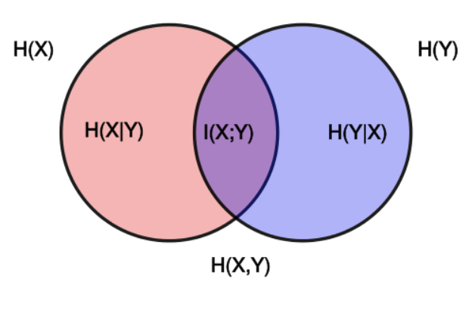
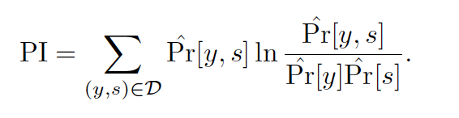

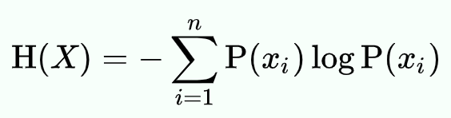
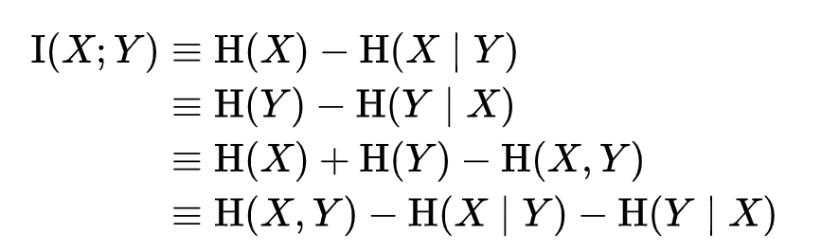
Prejudice Index (Indirect Prejudice)
Prejudice Index (PI):
Information Entropy
Normalized Prejudice Index (NPI):
Mutual Information
Notes:
H: Joint entropy
Info entropy: how much uncertainty inside the information/surprise
PI=H(Y ) is the ratio of information of S used for predicting Y ,
PI=H(S) is the ratio of information that is exposed if a value of Y is known.
Geometric mean

Slide 12

Underestimation
A classifer has not yet converged
Negative legacy
Unfair labeling in the training data

Slide 13
Outline
Applications
fairness-aware data mining applications
Difficulty in Fairness-aware Data Mining
Calders-Verwer’s discrimination score, red-lining effect
Fairness-aware Classification
fairness-aware classification, three types of prejudices
Methods
prejudice remover regularizer, Calders-Verwer’s 2-naïve-Bayes
Experiments
experimental results on Calders&Verwer’s data and synthetic data
Related Work
privacy-preserving data mining, detection of unfair decisions,
explainability, fairness-aware data publication
Conclusion

Slide 14
Logistic Regression with Prejudice Remover Regularizer
Add ability to adjust distribution of Y depending on the value of S
Logistic Regression
Application: applied to any algorithms with probabilistic discriminative
models and are simple to implement.
Notes:
ability: penalty
enforces a classier's independence from sensitive information

Slide 15
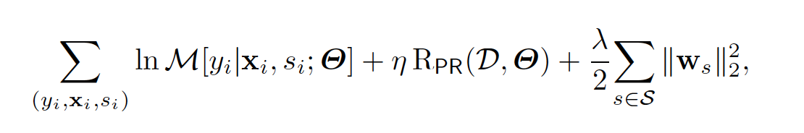
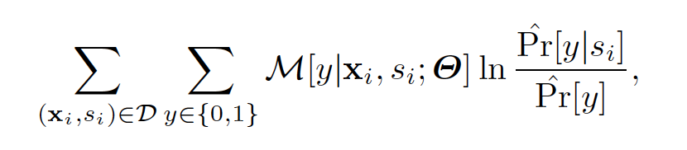
No Indirect Prejudice Conditon
Add a constraint of a no-indirect-prejudice condition
model
parameter
regularization
parameter λ
L2 regularizer
avoiding
over fitting
η : fairness
parameter
the larger value
more enforces
the fairness
Prejudice Remover Regularizer
the smaller value
more strongly constraints
the independence between Y and S

Slide 16
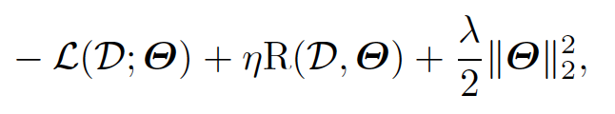
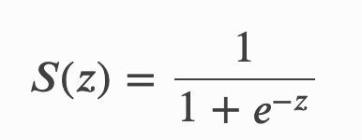
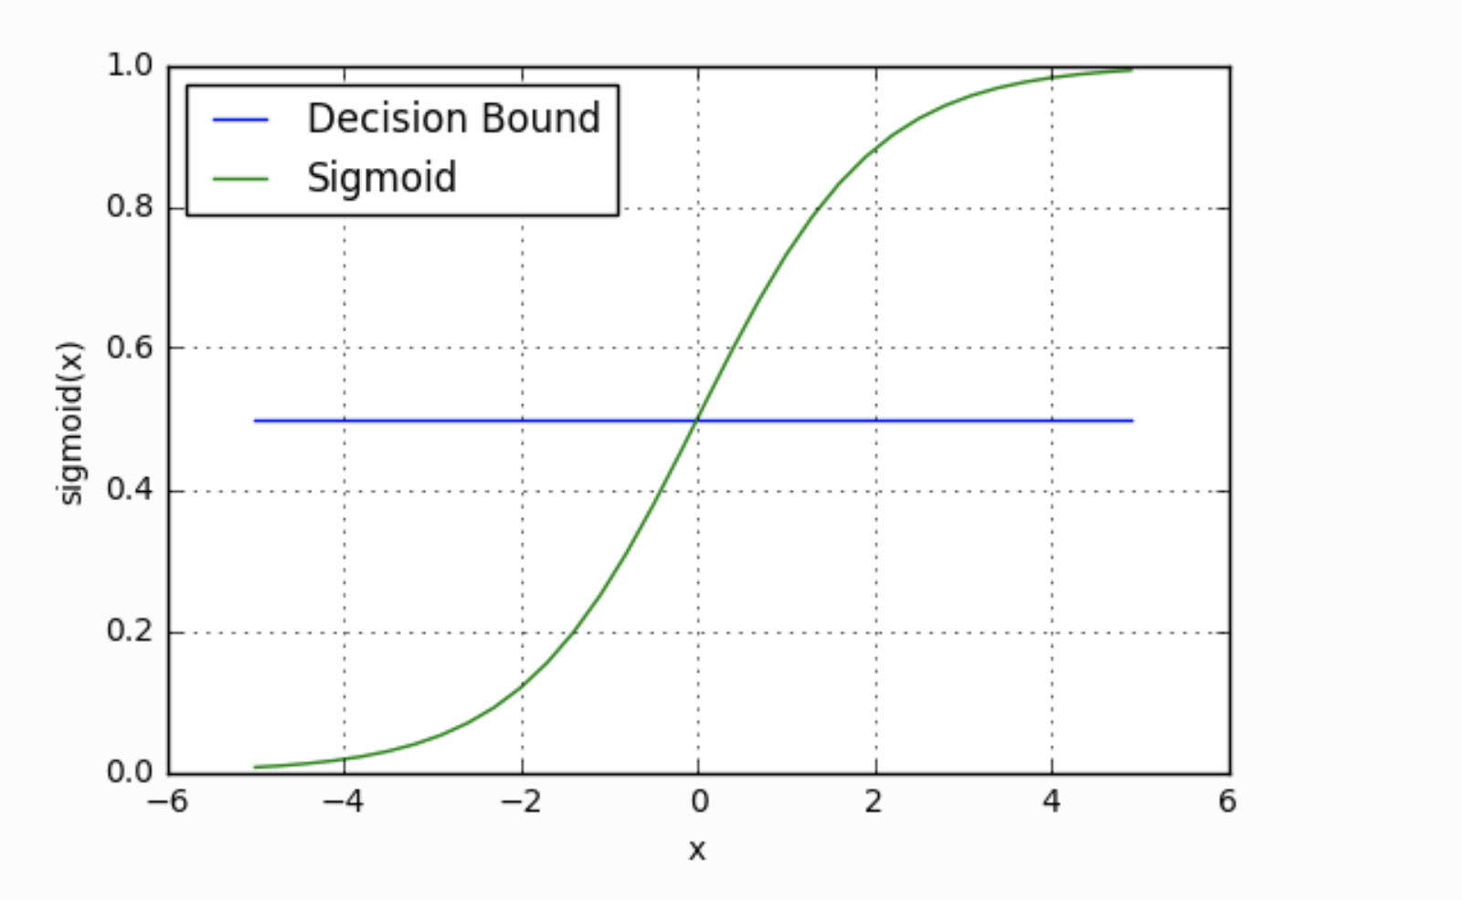
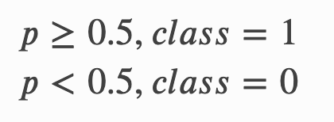
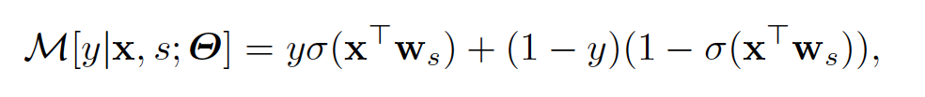
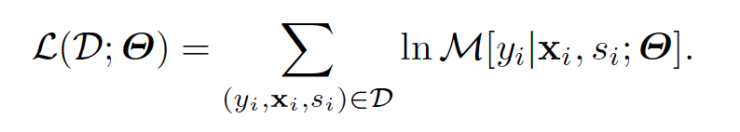
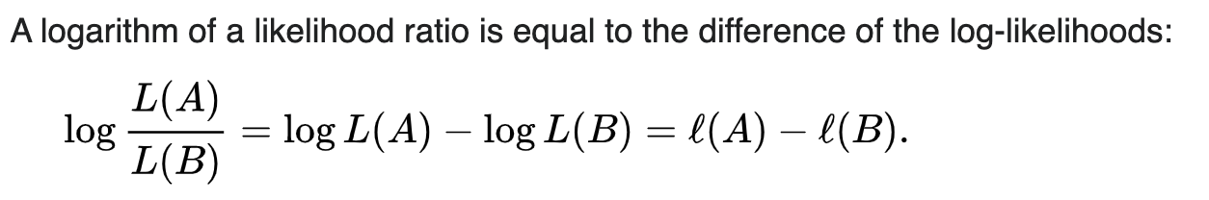
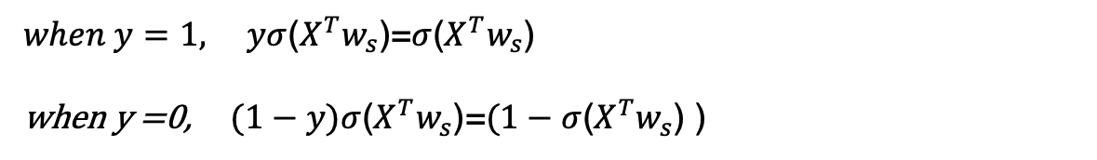
Log-likelihood
$when y=1, yσ$($X^{T}w_{s}$)=$σ$($X^{T}w_{s}$)
when y =0, $(1−y)σ$($X^{T}w_{s}$)=$(1−σ$($X^{T}w_{s}$) )

Slide 17
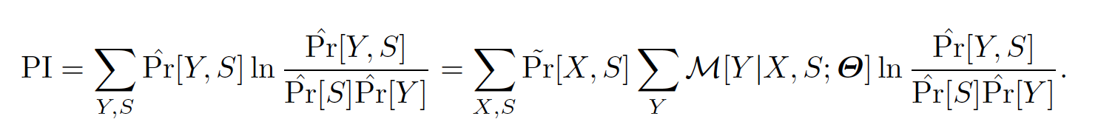
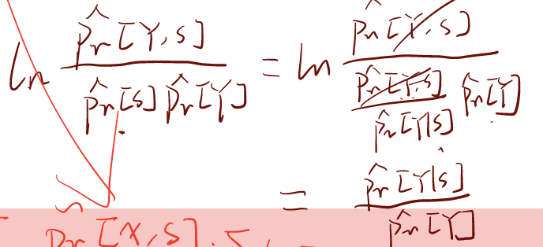

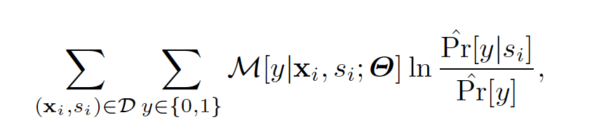
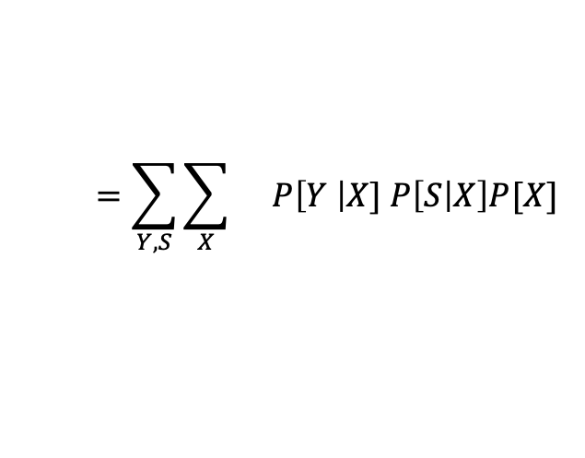
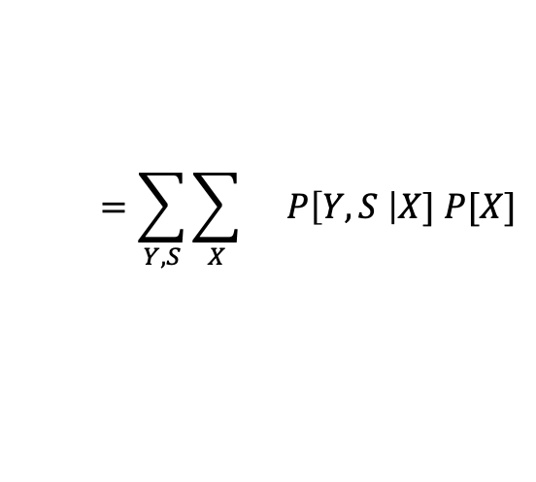
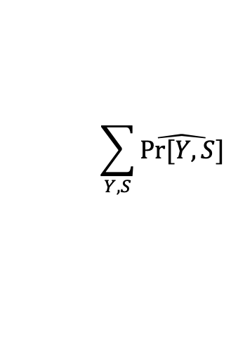

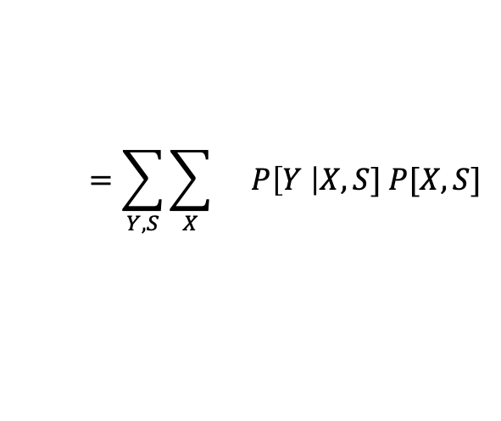
Prejudice Remover Regularizer
no-indirect-prejudice condition = independence between Y and S
Prejudice Remover Regularizer
mutual information between Y (objective variable) and S (sensitive feature)
$$\sum_{Y,S}{\hat{Pr⁡[Y,S]}}$$
$$=\sum_{Y,S}{\sum_{X}{}}P\left[Y,S \right|X] P[X]$$
$$=\sum_{Y,S}{\sum_{X}{}}P\left[Y \right|X] P\left[S | X\right]P[X]$$
Y $⊥$ S | X
$$=\sum_{Y,S}{\sum_{X}{}}P\left[Y \right|X,S] P[X,S]$$

Slide 18
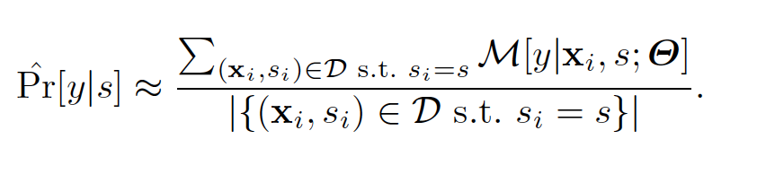
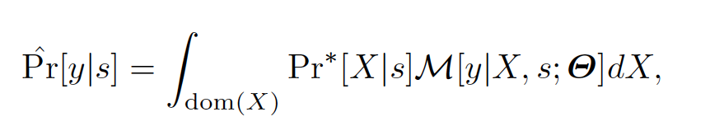
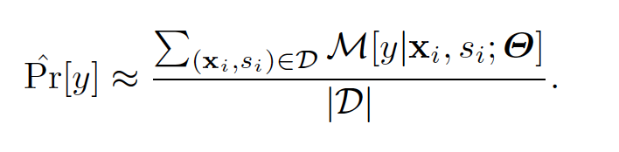
Prejudice Remover Regularizer
expectation over X and S
is replaced with
the summation over samples
This distribution can be derived by marginalizing over X
But this is computationally heavy...
approximate by the sample mean over X for each pair of y and s
Limitation: This technique is applicable, only if both Y and S are discrete

Slide 19
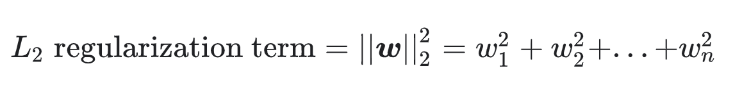
L2 regularizer
L₂ regularization: sum of the squares of all the feature weights:
Notes:
½ scaling constant

Slide 20
Calders-Verwer’s 2 Naïve Bayes
Naïve Bayes
Calders-Verwer Two
Naïve Bayes (CV2NB)
Y
Y
S
X
S
X
non-sensitive features X are
mutually conditionally
independent given Y and S
S and X are conditionally
independent given Y

Slide 21
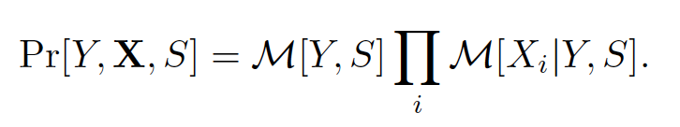
Calders-Verwer’s 2 Naïve Bayes
It is as if two naïve Bayes classifiers are learned depending on each value of the sensitive feature
while CVscore > 0
if # of data classified as “1” < # of “1” samples in original data then
increase M[Y=+, S=-], decrease M[Y=-, S=-]
else
increase M[Y=-, S=+], decrease M[Y=+, S=+]
reclassify samples using updated model M[Y, S]
Update the joint distribution so that its CV score decrease

Slide 22
Outline
Applications
fairness-aware data mining applications
Difficulty in Fairness-aware Data Mining
Calders-Verwer’s discrimination score, red-lining effect
Fairness-aware Classification
fairness-aware classification, three types of prejudices
Methods
prejudice remover regularizer, Calders-Verwer’s 2-naïve-Bayes
Experiments
experimental results on Calders&Verwer’s data and synthetic data
Related Work
privacy-preserving data mining, detection of unfair decisions,
explainability, fairness-aware data publication
Conclusion

Slide 23
Experiments
Calders & Verwer’s Test Data
Adult / Census Income @ UCI Repository
Y : a class representing whether subject’s income is High or Low
S : a sensitive feature representing whether subject’s gender
X : non-sensitive features, all features are discretized, and 1-of-K representation is used for logistic regression
# of samples : 16281
Methods
LRns : logistic regression without sensitive features
NBns : naïve Bayes without sensitive features
PR : our logistic regression with prejudice remover regularizer
CV2NB : Calders-Verwer’s two-naïve-Bayes
Other Conditions
L2 regularization parameter λ = 1
five-fold cross validation

Slide 24
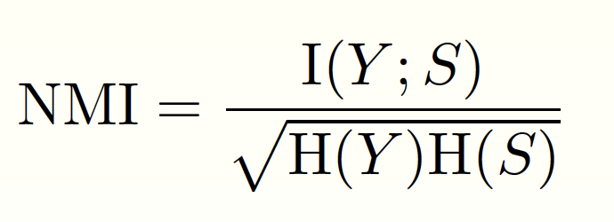
Evaluation Measure
Accuracy
How correct are predicted classes?
the ratio of correctly classified sample
NMI (normalized mutual information)
How fair are predicted classes?
mutual information between a predicted class and a sensitive feature, and it is normalized into the range [0, 1]

Slide 25
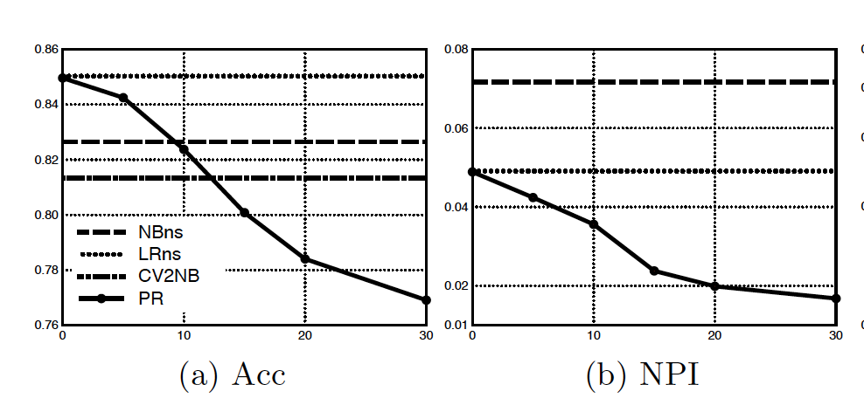
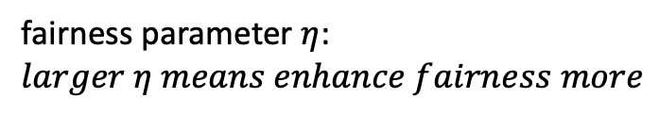


Higher Accuracy
Fairer
$$η$$
fairness parameter $η$: $larger η means enhance fairness more$
$$η$$
accuracy
fairness(NPI)
PR (Prejudice Remover) could make fairer decisions than pure LRns (logistic regression) and NBns (naïve Bayes)
PR could make more accurate prediction than NBns or CV2NB
CV2NB achieved near-zero NMI, but PR could NOT achieve it

Slide 26
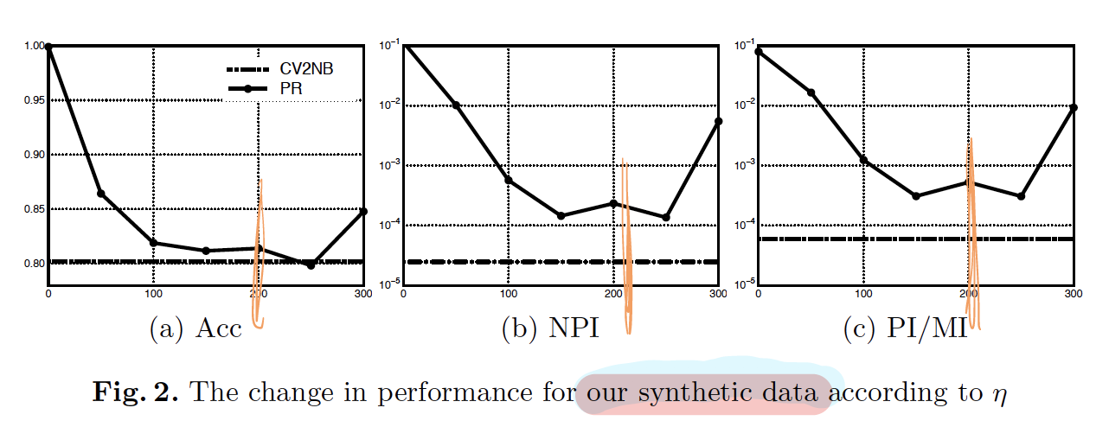
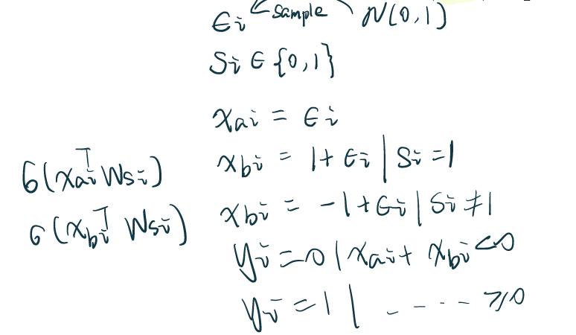
Synthetic Data
Why did our prejudice remover fail to make a fairer prediction than that made by CV2NB?

Slide 27
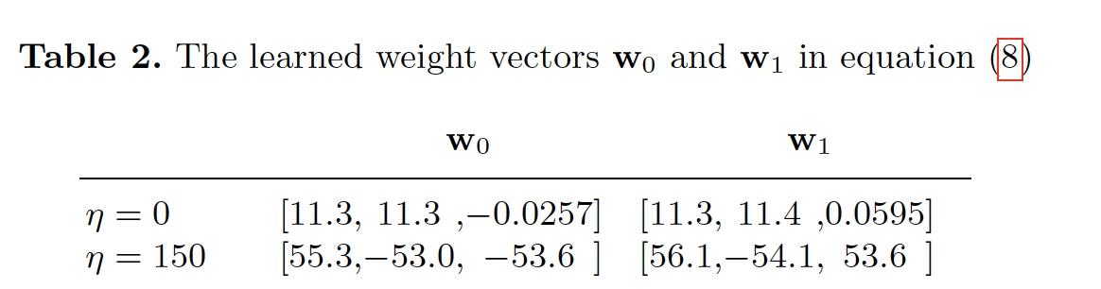


Synthetic Data
$$x_{ai}$$
$$x_{bi}$$
When η=0, PR regularizer doesn’t affect weights
When η=150, w(xbi) < w(xai).
Notes:
Therefore, if there are features that are useful for classification and additionally independent from a sensitive feature, PR can remove prejudice effectively.
the absolute values of weights for xbi were smaller than those for xai.
This indicates that to remove prejudice, our PR tries to ignore
features that depend on a sensitive feature.

Slide 28
Outline
Applications
fairness-aware data mining applications
Difficulty in Fairness-aware Data Mining
Calders-Verwer’s discrimination score, red-lining effect
Fairness-aware Classification
fairness-aware classification, three types of prejudices
Methods
prejudice remover regularizer, Calders-Verwer’s 2-naïve-Bayes
Experiments
experimental results on Calders&Verwer’s data and synthetic data
Related Work
privacy-preserving data mining, detection of unfair decisions,
explainability, fairness-aware data publication
Conclusion

Slide 29
Indirect prejudice
the dependency between a objective Y and a sensitive feature S
From the information theoretic perspective
mutual information between Y and S is non-zero
From the viewpoint of privacy-preservation
leakage of sensitive information when an objective variable is known
Kamiran : fairness in Decision trees
Finding Unfair Association Rules
Luong: Situation Testing

Slide 30
Outline
Applications
fairness-aware data mining applications
Difficulty in Fairness-aware Data Mining
Calders-Verwer’s discrimination score, red-lining effect
Fairness-aware Classification
fairness-aware classification, three types of prejudices
Methods
prejudice remover regularizer, Calders-Verwer’s 2-naïve-Bayes
Experiments
experimental results on Calders&Verwer’s data and synthetic data
Related Work
privacy-preserving data mining, detection of unfair decisions,
explainability, fairness-aware data publication
Conclusion

Slide 31
Opinions
Definition of fairness, sensitive variable
lack of convexity: local minima
binary sensitive variable and target variable
Socially responsible mining

